Slide 1

Olist Store : Data Analysis
By Hemant Gupta

Slide 2
Overview
This report provides a comprehensive overview of Olist Store covering various facets of its operations and performance over the span of 3 years.
We have analyzed a wide range of data, including transaction records, geographical traffic and customer behaviour to offer insights into key areas such as sales, customer retention, product performance, and user experience.
Throughout this report, we will highlight key findings and recommendations that can guide Olist Store in making data-driven decisions to enhance its e-commerce operations and foster sustainable growth.

Slide 3





Overview
We have analyzed a wide range of data, including transaction records, geographical traffic and customer behaviour to offer insights into key areas such as sales, customer retention, product performance, and user experience
This report provides a comprehensive overview of Olist Store covering various facets of its operations and performance over the span of 3 years
Throughout this report, we will highlight key findings and recommendations that can guide Olist Store in making data-driven decisions to enhance its e-commerce operations and foster sustainable growth

Slide 4
About the Data
The dataset has information on 100,000 orders from 2016 to 2018 from several sellers located in Brazil.
The orders include details such as order status, price, payment, customer location, product categories, and reviews written by customers. The geolocation data is associated to Brazilian zip codes with latitude and longitude coordinates.

Slide 5
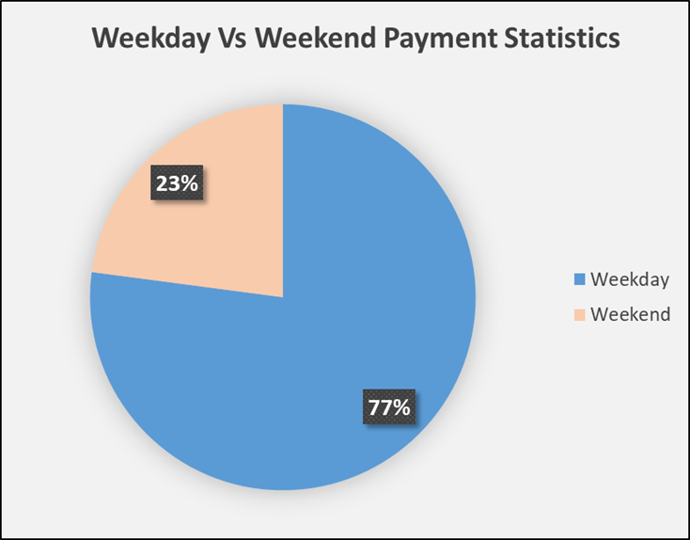
KPI 1: Weekday Vs Weekend Payment Statistics
It is evident that customers display a clear payment behavior pattern. The majority of payments occur during weekdays while the weekend sees a decline in payment activity. This can have a substantial impact on the store's revenue stream.
To address the weekend payment decline, the client can consider implementing targeted promotion campaigns on weekends. These promotions could include weekend-specific discounts, flash sales, or limited-time offers to motivate customers to make purchases during these days.

Slide 6
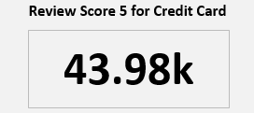
KPI 2: Orders With Review Score 5 And Payment Type As Credit Card
It was observed that the number of orders with a review score of 5 is significantly higher when customers use credit cards as their payment method, compared to other payment types.
Client can promote credit card payments by providing clear incentives such as cashback rewards, loyalty points, or exclusive discounts for customers who choose this payment method.
However, it's crucial to improve the experience for other methods. It has to be ensured that the process for alternative payment options is as smooth and secure as possible, and consider offering additional benefits or assurances to build trust in these methods.

Slide 7
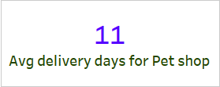
KPI 3: Average Number Of Delivery Days Taken For Pet Shop
An average delivery time of 11 days suggests that the Pet Shop may have an efficient and quick delivery process.
The Pet Shop should also assess what delivery times competitors in the same industry offer, this can help in setting realistic benchmarks for improvement.
Collecting feedback from customers about their delivery experiences can provide valuable insights into specific areas of improvement.

Slide 8
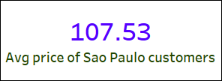
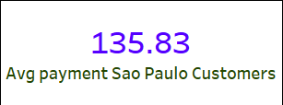
KPI 4: Average Price & Payment Values From Customers Of Sao Paulo City
High payment value and low average prices compared to others cities indicates a strategic emphasis on gaining market share and maximizing revenues.
The business may have deep understanding of the competitive landscape in Sao Paulo and uses pricing as a strategic tool to stand out among competitors.
Providing a balance of lower prices and high-quality products or services may contribute to customer loyalty and repeat business in Sao Paulo.
Same tactic can be applied to gain confidence in other cities as well.

Slide 9
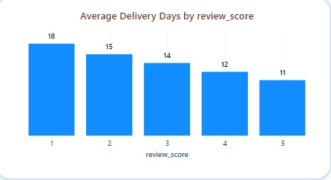
KPI 5: Relationship Between Shipping Days Vs Review Scores
We noticed an inverse relationship between the number of shipping days required for an order to reach the customer and the review scores provided by customers. In other words, as the shipping duration increases, the review scores tend to decrease.
To enhance customer satisfaction and improve review scores, prioritize shipping and delivery processes. Aim to reduce shipping times by implementing efficient logistics, exploring local distribution centers, and offering faster delivery options for customers willing to pay extra for express shipping.

Slide 10


Conclusion
In conclusion, our analysis of the dataset containing information on 100,000 orders spanning the years 2016 to 2018 from multiple marketplaces in Brazil has unveiled several critical insights that can guide Olist toward improved operational efficiency and customer satisfaction.
Actively engaging customers post-purchase, ensuring product quality, maintaining a customer-friendly return policy, and providing responsive customer support are essential strategies to ensure customer retention.
It is important to address quicker shipping and delivery times as a crucial element in the e-commerce customer experience.
Continuous monitoring, data analysis, and adaptation to evolving customer feedback will be key in maintaining and improving the performance and reputation in the highly competitive e-commerce market.
Setting realistic delivery expectations and offering order tracking and notifications can provide transparency and manage customer expectations effectively.
Thank You

